Slide 1
Digital Communication 23EC2208
Digital Carrier Modulation
Dr. M. Venu Gopala Rao
A.M.I.E.T.E, M.Tech, Ph.D(Engg)
Cert. in R.S.T ( City & Guild’s London Institute, London)
F.I.E.T.E, L.M.I.S.T.E, I.S.O.I., S.S.I., M.I.A.E.
Professor, Dept. of ECE, K L University
mvgr03@kluniversity.in

Slide 2
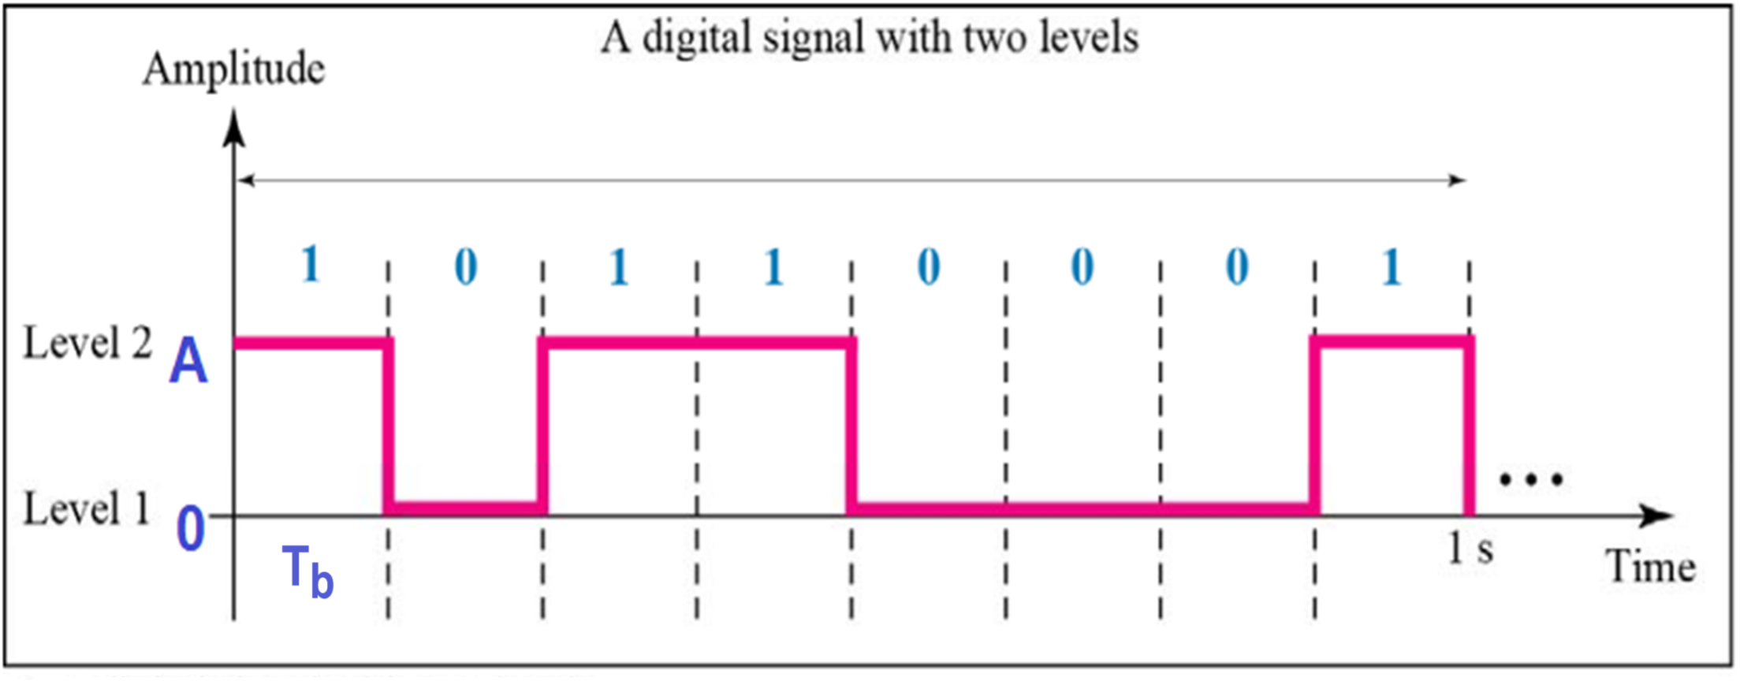

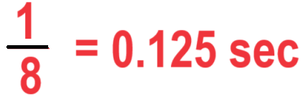
Digital Signals
In addition to being represented by an analog signal, information can also be represented by a digital signal.
For example, a 1 can be encoded as a positive voltage and a 0 as zero voltage as shown below:
Bit rate is defined as the number of bits transmitted over a second.
Hence the above digital data bit rate is 8 bits per second or bps.
What is the bit period / duration ?
What is the bit rate for this digital signal?

Slide 3
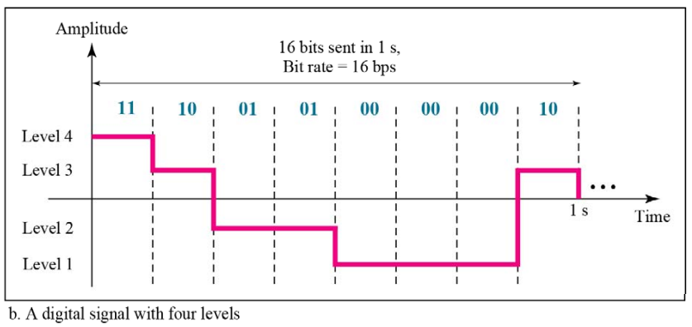
Digital Signals
A digital signal can have more than two levels as shown below. In this case, we can send more than 1 bit for each level.
Each pulse is represented by two bits. Hence in this case the bit-rate is 8 x 2 = 16 bps

Slide 4
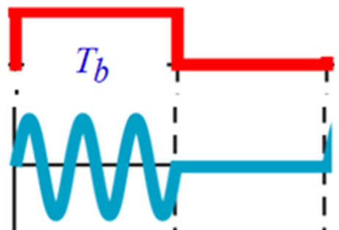
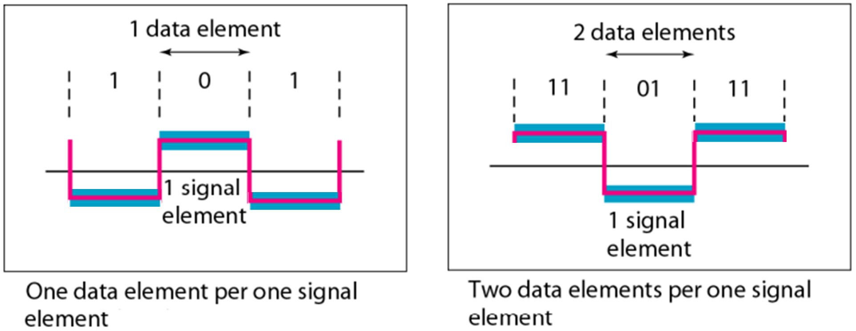
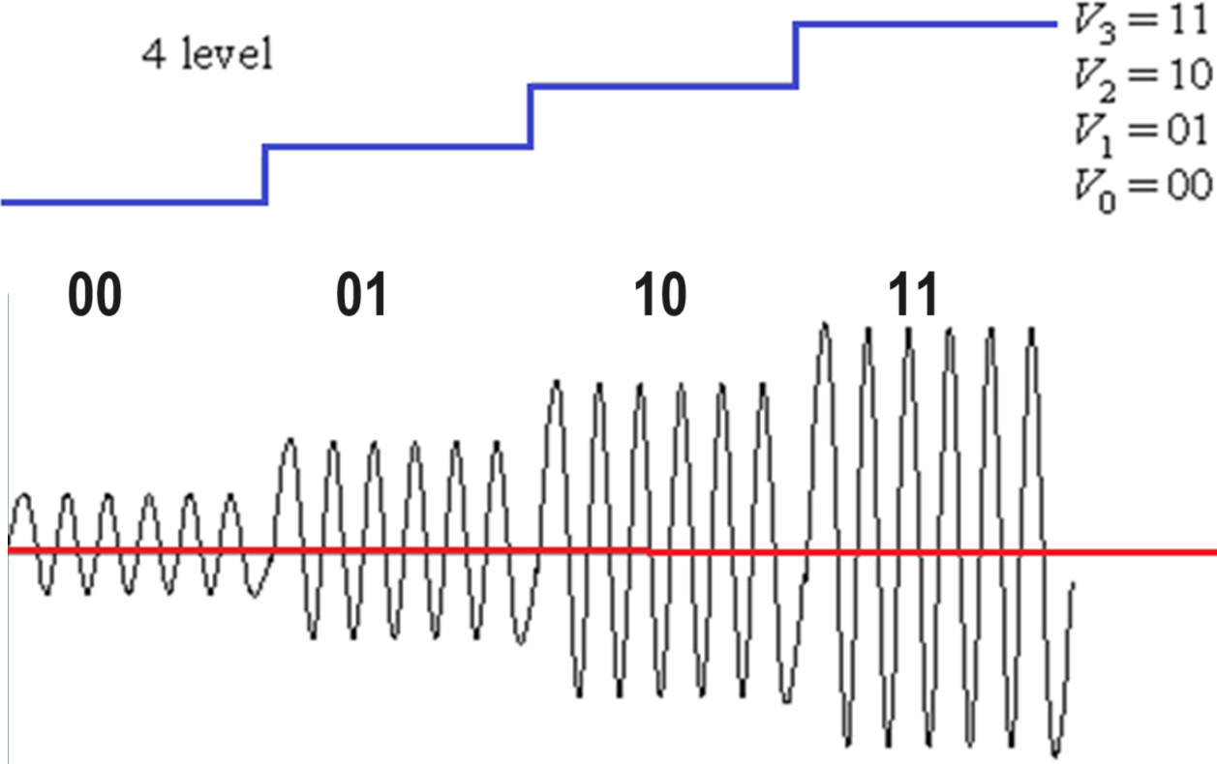
Signal element versus data element
A data element is the smallest entity that represent a piece of information; this is the bit.
A signal elements is the shortest unit (timewise) of a digital signal.
In other words, data elements are what we need to send; signal element are what we can send.

Slide 5
Bit rate and Baud rate
Bit rate is the number of bits transmitted over a second.
Baud rate is the number of signal units transmitted over a second.
Baud rate is less than or equal to the bit rate.
Baud rate = Bit rate / no. of bits per signal unit

Slide 6
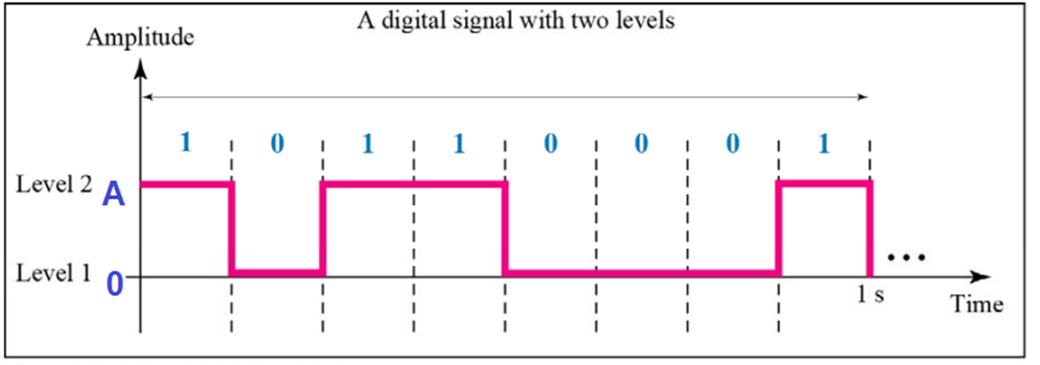
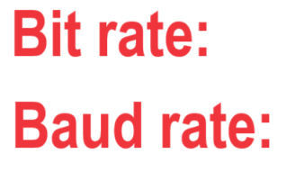

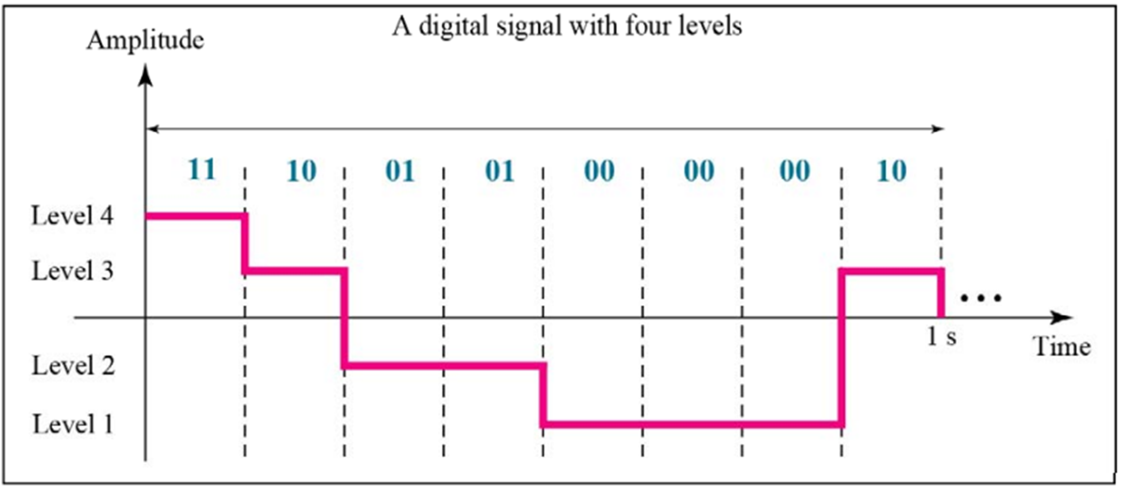


Slide 7
Ex1: An analog signal carries 4 bits per signal element. If 1000 signal elements are sent per second, find the bit rate.
Ans: Baud rate = 1000, No. of elements N = 4;
Bit rate = 1000 X 4 = 4000 bps.
Ex2: An analog signal has a bit rate of 8000 bps and a baud rate of 1000 baud. How many data elements are carried by each signal element? How many signal elements do we need?
Data elements = Bit rate / baud rate = 8 bits / baud
Then the number of signal elements L = 2⁸ = 256 levels.

Slide 8
Bandwidth
The actual bandwidth necessary to propagate a given bit rate depends on several factors,
including the type of encoding and modulation used,
the types of filters used, system noise, and
desired error performance.
The ideal bandwidth is generally used for comparison purposes only.
The relationship between bandwidth and bit rate also applies to the opposite situation. For a given bandwidth (B), the highest theoretical bit rate is 2B.

Slide 9


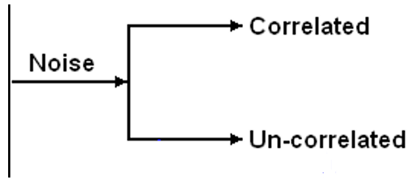








Slide 10

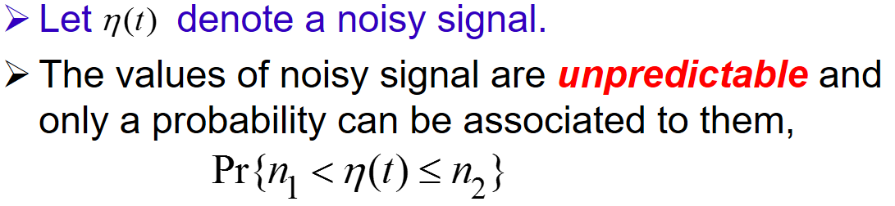
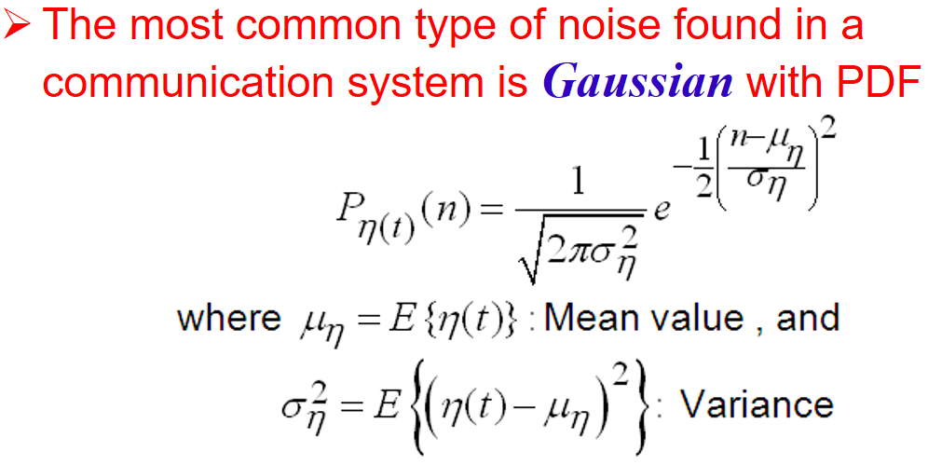

Slide 11

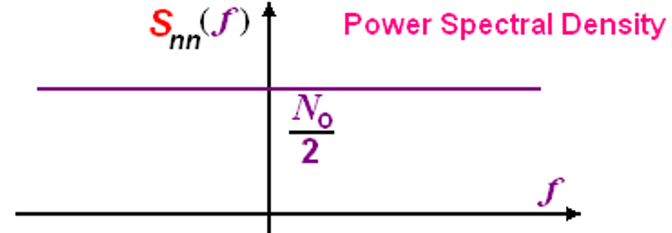
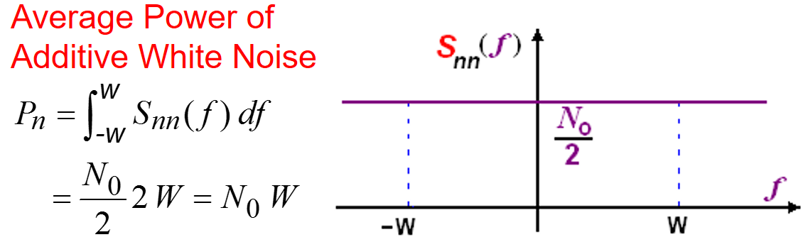

Slide 12

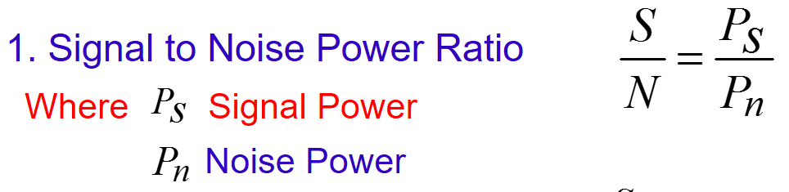
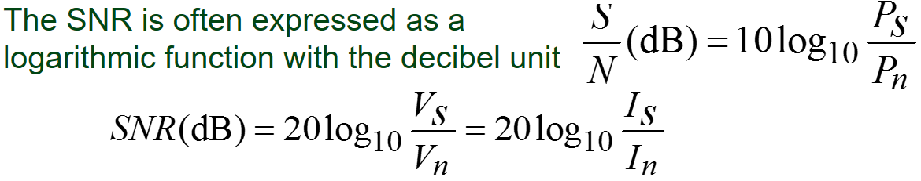
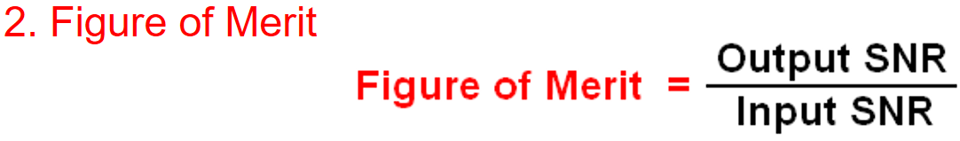
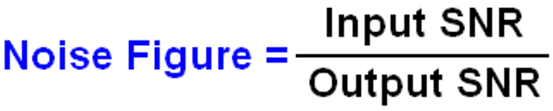

Slide 13

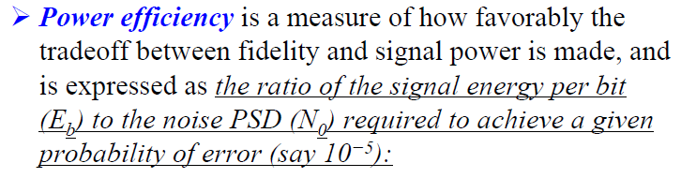
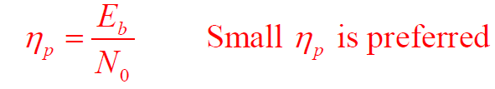
Performance Measures

Slide 14
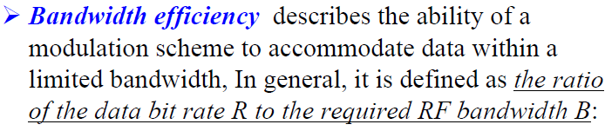


Slide 15
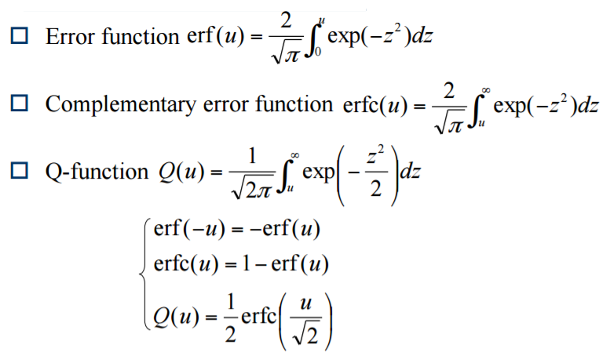
Error Function

Slide 16
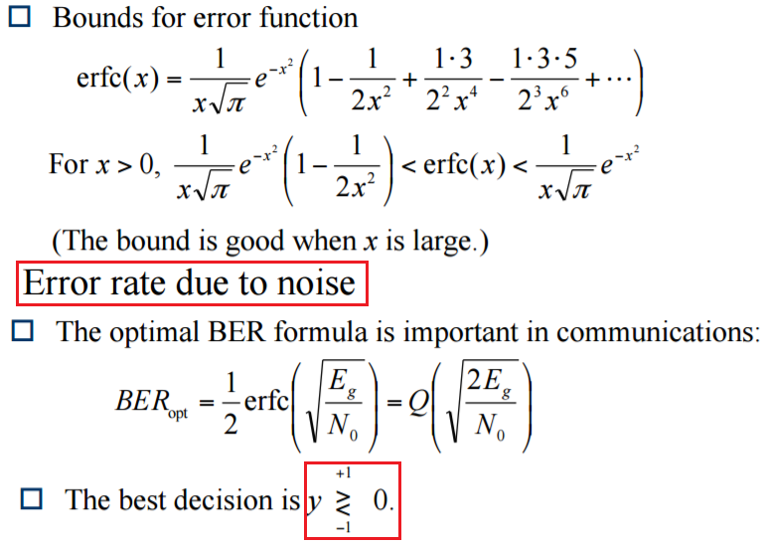
Error Function

Slide 17
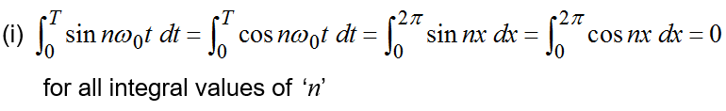



Orthogonal Properties of Sine and Cosine Terms

Slide 18
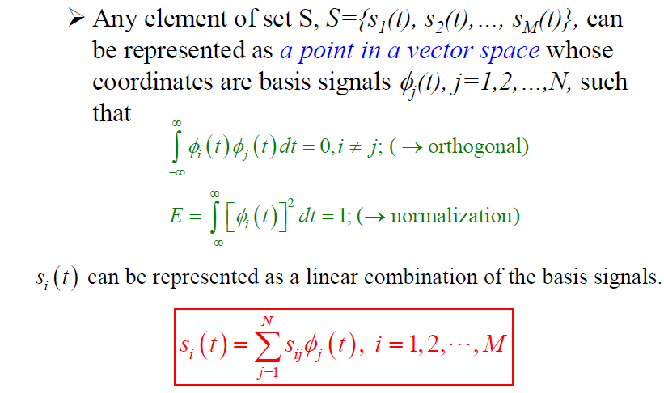

Slide 19
End

